Slide 1
Vehicle Number Plate Detection Identify the license plate in the image and do an OCR to extract the character from the detected license plate
Name: Shanu Dey
Github: github.com/ShanuDey
Telegram: @ShanuDey

Slide 2
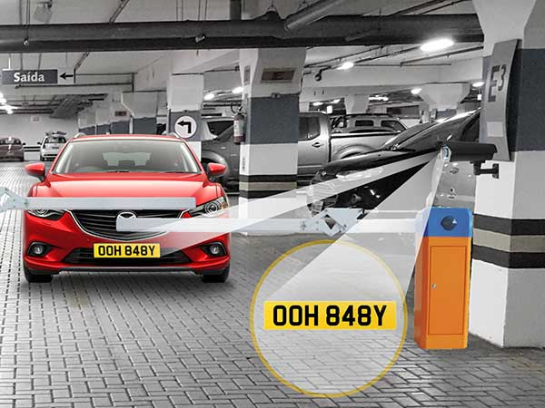
Introduction

Slide 3
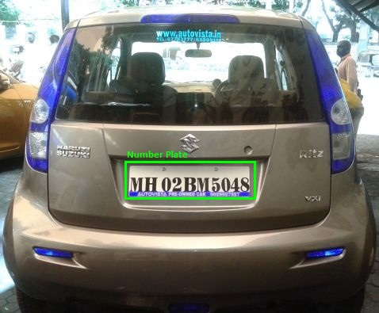
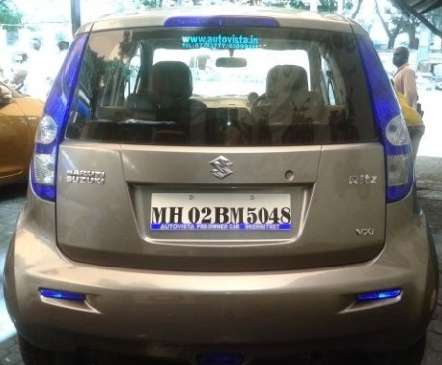

Working Principle
License Plate Detection using YOLO
Optical Character Recognition using pytesseract
MH 02 BM 5048

Slide 4
Demo of the solution

Slide 5
References
Image source: https://bigdata-madesimple.com/wp-content/uploads/2019/02/numberplate.jpg
Yolo: https://pjreddie.com/darknet/yolo/
Tesseract: https://github.com/tesseract-ocr/tesseract
Notebook:https://colab.research.google.com/drive/1jqql1dJwQzlAiGdLw8FF_JmyfL5HCbP1
Github: https://github.com/ShanuDey/Vehicle-Number-Plate-Detection-and-OCR-identification

